Slide 1

PROJECT MANAGEMENT TOOL
COLLABORATION TOOLS FOR PEOPLE TO WORK VIRTUALLY

Slide 2
TEAM 1 : AVENGERS ASSEMBLE
Akhila Katukuri
Claudia Dsilva
Sai Jeevan Teegala
Vamshi Krishna Shanagonda
Vikas Sanhotra

Slide 3
WHAT IS PROJECT MANAGEMENT TOOL?
Project management tool is an aid to assist an individual, team or organization to effectively organize work, projects and tasks.
This tool is made to be completely customizable so they can fit the needs of teams of different sizes and with different goals.
Projects are composed of several, interconnected projects that, when combined, achieve a larger, long-term business objective.
This means Project Management tool will need advanced features to track projects at a higher-level in order to see how each project is interacting with each other. This tool can include flexible work views, Dashboard, Reporting, Time sheets.

Slide 4
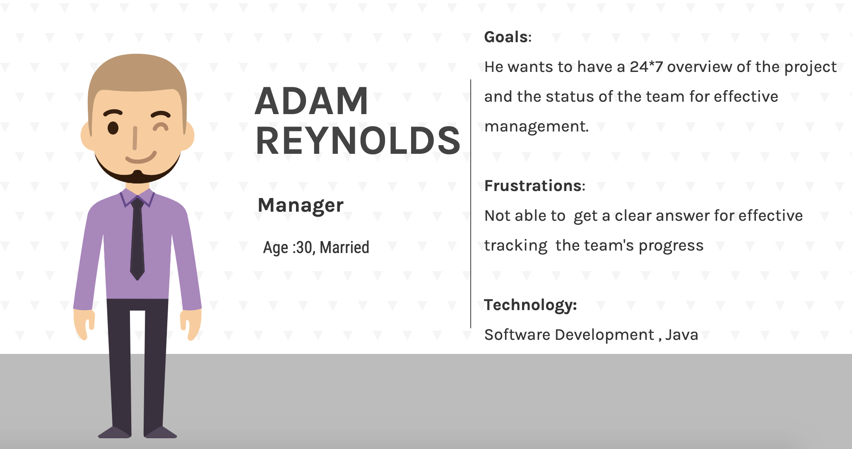
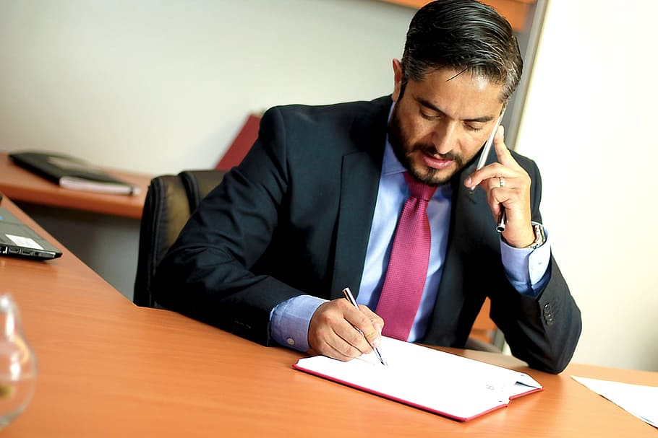
PERSONAS
MANAGER:
has ultimate control over teams and projects.
gets to create and allocate tasks to the team members.
creates custom roles and grant access levels to the team members.
gets to keep an eye on the task status of team members.
has access to repository , chat box and other functions

Slide 5

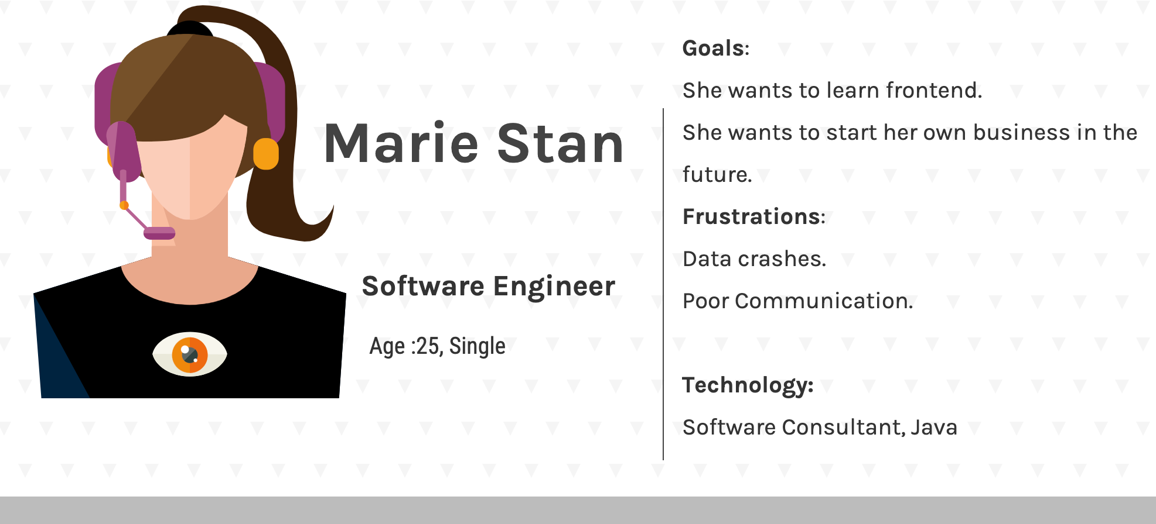
Personas
TEAM MEMBER:
can see the work allocated to them along with deadlines.
can change the status of the task assigned on completion.
has access to repository , chat box and other functions

Slide 6
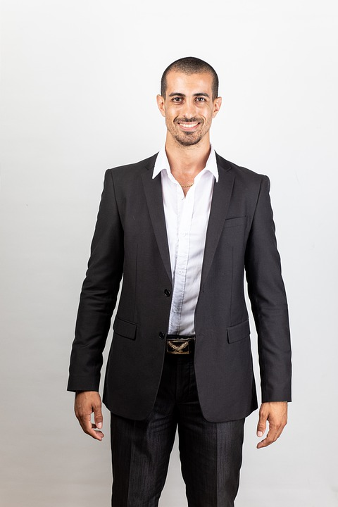
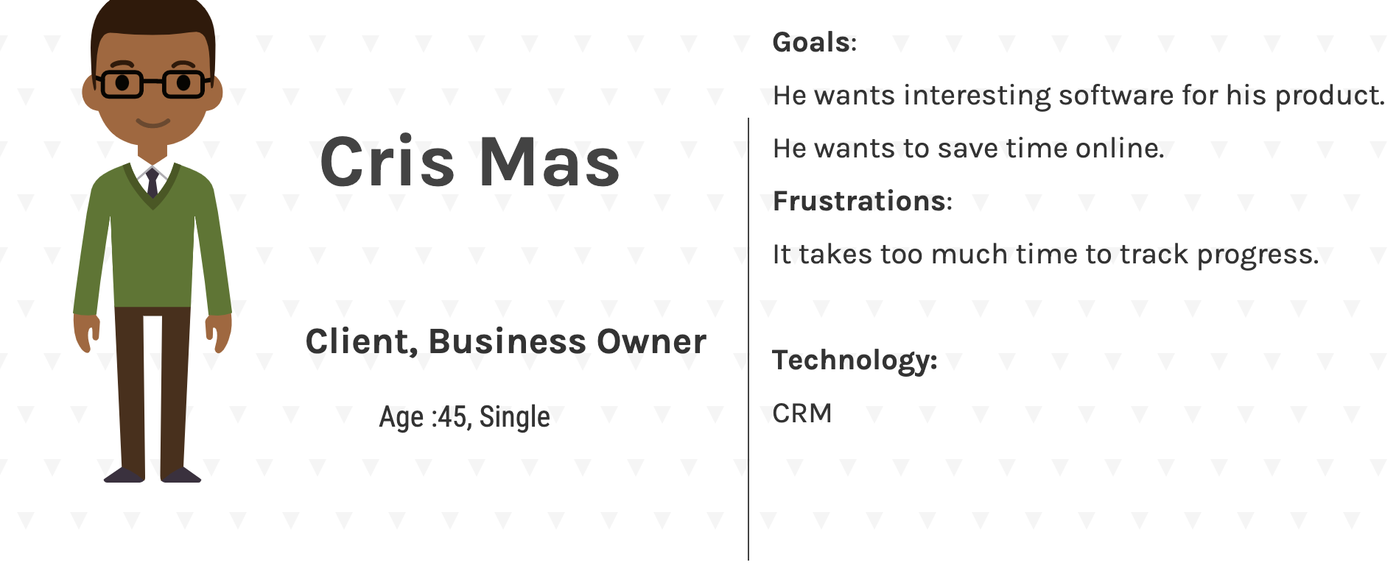
Personas
https://docs.google.com/presentation/d/1daGki1TjJgnAgYnM6ifr0UdBadEi6b_Q/edit#slide=id.p13
CLIENT:
can see the work allocated to the members along with deadlines.

Slide 7
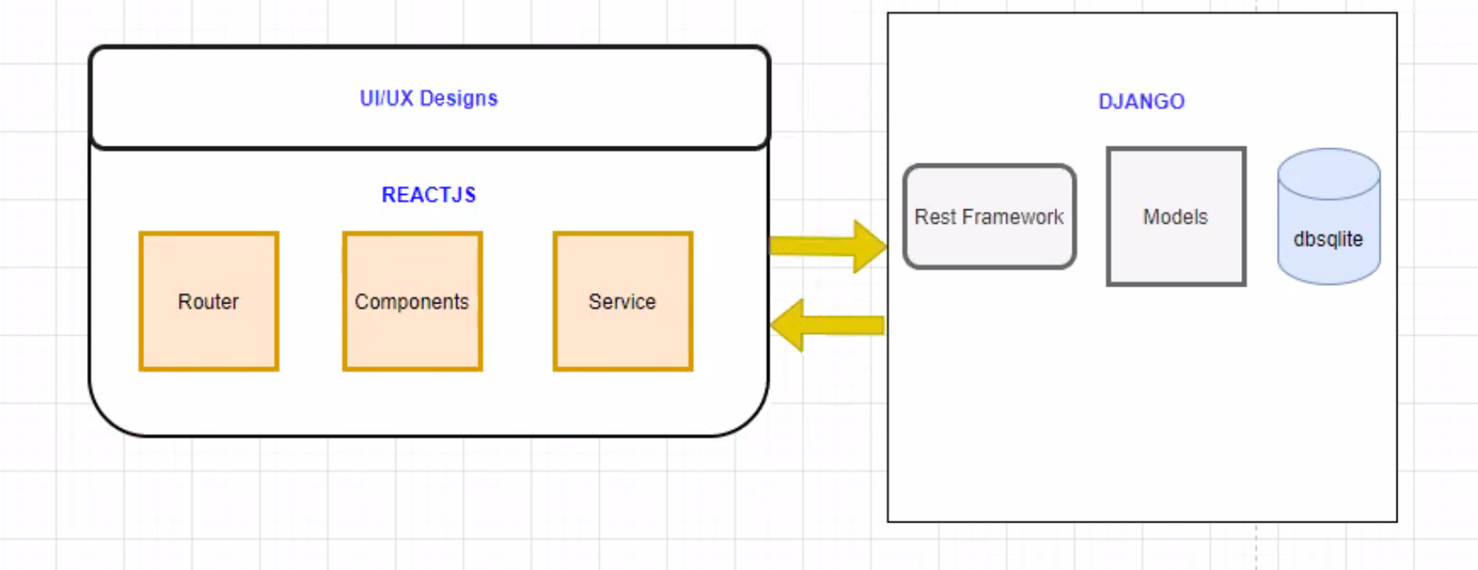

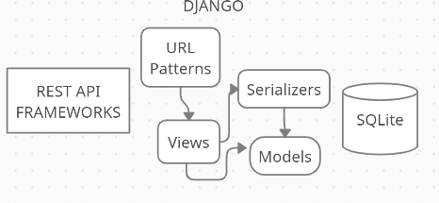


Technologies Used
Front-end
Back-end
Backend
Frontend
Python Django Framework
JSON files
React Js
HTML5
BOOTSTRAP
SQLite3 Database

Slide 8
User Stories and Acceptance Criteria
User story 1: Registration
As a manager: I should be able to sign up for the application successfully as a first time user.
b. As a team member: I should be able to able to sign up for the application successfully as a first time user.
c. As a client : I should be able to able to sign up for the application successfully as a first time user.
Acceptance Criteria: Any person who gives the mandatory required details such as first name, last name, username, password, confirm password and a valid email ID will be able to successfully register as a user to the website.
User story 2: Login
a. As a manager: I should be able to login successfully as a valid user to view the homepage.
b. As a team member : I should be able to login successfully as a valid user to view the homepage.
c. As a client : I should be able to login successfully as a valid user to view the homepage.
Acceptance Criteria: Once the user registers, (s)he must encounter a login page where they have to enter a valid “username” and password for a secure login. If not the login is not successful or if the user forgets their Username or password they should be able to get their password recovery options.

Slide 9
User Stories and Acceptance Criteria
User story 3 : Tasks and Project
a. As a manager: I should be able to create project and assign tasks to team member, delete or update tasks .
b. As a team member: I should be able to see the tasks that are assigned to me and update it if is completed.
c. As a client : I should be able to view all the tasks are that present along with status.
Acceptance Criteria: 1.The team members should have a complete access to their accounts so that they can check their own tasks and update them when completed. The task will have a “completed” button to confirm the completion.
2.The manager should be able to create a new project and should have a separate function under project where (s)he can add task to the members based on the project.
User story 4 : Chat function
a. As a manager: I should be able to chat with all the members of team and the client.
b. As a team member : I should be able to chat with all the members of the team along with the manager and client.
c. As a client : I should be able to chat with all the members of the team along with the manager
Acceptance Criteria:All the users should have access to the chat box so that they can discuss or give suggestion etc over chat to the team. This chat function works whenever a user send a particular message to other, it should reflect in the others chatroom.

Slide 10
User Stories and Acceptance Criteria
User story 5 : Timelines
As a manager: I should be able to add timelines to the tasks assigned to team members.
Acceptance Criteria:Manager should be able to give the end-date to a task to keep track of the deadlines.
User story 6 : Repository
As a manager: I should be able to see and download the documents that are present and also be able to upload new documents.
b. As a Team Member: I should be able to see and download the documents that are present and also be able to upload new documents.
Acceptance Criteria:The developer should create a repository to store all the required data. The Manager and Team Member can view,edit or update the documents present in the repository.

Slide 11
User Stories and Acceptance Criteria
User story 7 : Dashboard
a. As a manager: I should be able to add/update projects and task and have access to different modules present on the dashboard.
b. As a team member: I should be able to view and complete tasks assigned to me and have access to different modules present on the dashboard.
c. As a client : I should be able to view the project and tasks and some selective modules present on it
Acceptance Criteria: 1.The users should have a complete access to the dashboard according to their roles so that they can check their own project , tasks and update them when completed.
2.The tasks assigned will in tabular format specific to their role.It will have access to other modules like chat, repository, calendar etc.
User story 8 : Calendar
a. As a manager: I should be able to access the calendar and add events to it.
b. As a team member: I should be able to access the calendar and add events to it.
Acceptance Criteria: 1.The users should have a access to the calendar, so that they can check and add events or set reminders for the tasks assigned to them.

Slide 12
PROJECT FLOW DIAGRAM
FOR MANAGERS:
Manager
Register
Login
Access to Dashboard
Can Perform
Add Projects
Assign Tasks
Chat with Team Members
Update and view Repository
Update Profile

Slide 13
PROJECT FLOW DIAGRAM
FOR TEAM-MEMBERS:
Team Member
Register
Login
Access to Dashboard
Can Perform
Update Task Status
Chat with Team Members
Update and view Repository
Update Profile

Slide 14
PROJECT FLOW DIAGRAM
FOR CLIENTS:
Client
Register
Login
Access to Dashboard
Can Perform
View the task

Slide 15
Product Backlog
User Story ID | User Story | As a… (Persona) | I want to be able to | So That | Priority | Sprint | Status
1 a | Registration | Manager | Register as Manager | I can register with my details and my user role as Manager to have access to the modules as manager | High | 1 | Done
1 b | Registration | Team members | Sign-up as a team-member | I can register with my details and m user role as team member to have access to the team members functionality | High | 2 | Done
1 c | Registration | Client | Sign-up as a Client | I can register myself as a viewer of that Project | High | 2 | Done
2 a | Login | Manager | Fill-up login details as an Manager | I can be successfully Logged in as a Manager | High | 1 | Done
2 b | Login | Team members | Fill-up login details as a Team Member | I can be able to login with my credentials as team member | High | 1 | Done
2 c | Login Page | Client | Login successfully as a Client | I can view the overall Progress of the Project | High | 4 | Done
3 a | Task and Project | Manager | Create Project Details | I can be able to create a new project as per requirement | High | 2 | Done
3 a | Tasks and Project | Manager | Define project details | I can assign project to the team members of the project. | High | 3 | Done
3 a | Tasks and Project | Manager | Define the task | I can assign different task of the project to the team members | High | 4 | Done
3 b | Tasks and Project | Team members | View the tasks assigned by manager | I can be able to check the tasks that are assigned to me and update once the task is completed.. | High | 4 | Done

Slide 16
Product Backlog
User story ID | User Story | As a… (Persona) | I want to be able to | So That | Priority | Sprint | Status
6 b | Repository | Manager | Get access to the repository | I can upload , download, share and edit the files in the repository | High | 5 | Done
6 b | Repository | Team members | Get access to the repository | I can upload download or view the repository uploaded by other team members | High | 5 | Done
4 a | Chat Function | Manager | chat with anyone | I can chat with team members and the client | High | 6 | In Progress
4 b | Chat Function | Team members | Chat with team member and manager | I can discuss about the project with the team members and manager | High | TBD | to be made
4 c | Chat Function | Client | chat with Manager | I can know the what's progress of the project | High | TBD | to be made
8 a | Calendar | Manager | Access, add events and set reminders | I can set priorities and deadlines for the project and tasks | High | 5 | In Progress
8 b | Calendar | Team members | Access, add events and set reminders | I can complete my task, keep track of the deadlines and have a schedule | High | 6 | to be made
7 b | Dashboard | Team members | Update my status on tasks | I can show my progress and that I have completed the task assigned | Moderate | TBD | to be made
7 a | Dashboard | Manager | Able to see the progress | I can view the overall progress of Project, teams and team members | Moderate | 5 | Done
7 c | Dashboard | All User | change my Profile | I can customize my page and my account | low | TBD | to be made

Slide 17
Test Cases
User Stories | Scenario | Test Cases | Expected Result | PASS/FAIL | Test Data | Sprint
1.Registration Manager Team members Client | Create account | Sign up with username, email ,roles and password | User should be able to sign up successfully | PASS | username:xxxx email: vsxxxx@pace.edu Role:Manager/ Role:Team member/ Role :Client | Sprint 1
 |  | Error message if password is not as per validations | Proper error message should be displayed | PASS
 |  | emails should be correct | Only Valid Email should be able to sign-up | PASS
 |  | Error message for invalid email | Proper error message should be displayed for invalid emails | PASS
 |  | All the user details should be persisted in the user table except password | User details email, username should be saved in the SQLite database | PASS
2.Login Manager Team members Client | Login Page | Sign in with valid email id and password | User should be able to login with email and password without any errors | PASS | User = vsxxxx@pace.edu Password: 123456m | Sprint 2
 |  | Reach the dashboard page | User should be redirected to the dashboard page after successful login User with Role:manager ,is directed to dashboard wherein he can add Projects updates tasks User with Role:Team Member is directed to dashboard wherein he can view his tasks and update status User with Role:client, directed to dashboard wherein he can view the tasks assigned | PASS
 |  | Error message for invalid email or password | User should be see proper error message for invalid email or password | PASS
7.Dashboard Manager Team members Client | Project Page | Update the work done | User team members can be able to update their tasks when completed | PASS |  | Sprint 3
 |  | View the progress | User team members and Manager can be able to view the progress of the tasks for the project | PASS

Slide 18
Test Cases Continued
User Story | Scenario | Test Cases | Expected Result | PASS/FAIL | Test Data | Sprint
3.Task and Project Manager Team Members Client | Dashboard or Home Page | Navigate to different Pages | User should be able to navigate to Projects, Tasks, Repository, Calendar and FAQ's | PASS |  | Sprint 4
 |  | Create and Assign projects and tasks as Manager | User Manager should be able to create, assign, view, add tasks or projects to teams and team members. | PASS
 |  | View and Update Tasks as team member | User team member should be able to view their assigned tasks and project and also update their work status. | PASS
 |  | View Project as Client | User Client should only view the progress of the Project | PASS
6.Repository Manager Team Member | Repository Page | Upload the work done | user team member and Manager should be able to upload any documents etc in the repository | PASS |  | Sprint 5
 |  | View the Project wok | user team member and Manager should be able to view any documents uploaded by other team members | PASS
 |  | Download the files | User team member and Managers should be able to download files and documents available in the repository | PASS
4.Chat function Manager Team Member Client | Messages | chat function | All team members , manager and client should be able to chat and discuss with each other | To be tested in next sprint |  | Sprint 6
8.Calendar Manager Team Member | Calendar Page | Access the calendar | User should be able to access and view the calendar | To be tested in next sprint |  | Sprint 6
 |  | Set reminders and add events | User should be able to add events and set reminders for the specific tasks assigned to them | To be tested in next sprint
7.Dashboard Manager Team Member Clients | User Details | Update firstname | User should be able to update first name and it should reflect on the account page | To be tested in next sprint |  | Sprint 7
 |  | Update last name | User should be able to update last name and it should reflect on the account page | To be tested in next sprint
 |  | Update password | Redirect to change password page to enter new password and then redirect to login page | To be tested in next sprint

Slide 19
Sprint 1 Backlog
User Story | As a… (Persona) | I want to be able to | So That | Priority
Registration | Manager | Register as Manager | I can register with my details and my user role as Manager to have access to the modules as manager | High
Login | Manager | Fill-up login details as an Manager | I can be successfully Logged in as a Manager | High
Login | Team members | Fill-up login details as a Team Member | I can be able to login with my credentials | High

Slide 20
Sprint 2 Backlog
User Story | As a… (Persona) | I want to be able to | So That | Priority
Tasks and Project | Manager | Create Project Details | I can be able to make project teams | High
Registration | Team members | Sign-up as a team-member | I can register with my details and my user role as Team Member to have access to the modules as Team Member | High
Registration | Client | Sign-up as a Client | I can register with my details and my user role as Client to have access to the modules as Client | High

Slide 21
Sprint 3 Backlog
User Story | As a… (Persona) | I want to be able to | So That | Priority
Tasks and Project | Manager | Define project details | I can give the name of the project along with members of the project. | High

Slide 22
Sprint 4 Backlog
User Story | As a… (Persona) | I want to be able to | So That | Priority
Tasks and Project | Manager | Define the task | I can assign different task of the project to team members | High
Tasks and Project | Team members | View the tasks assigned by manager | I can be able to check the tasks that are assigned to me. | High
Login | Client | Login successfully as a Client | I can view the overall Progress of the Project | High

Slide 23
Sprint 5 Backlog
User Story | As a… (Persona) | I want to be able to | So That | Priority
Repository | Member | Get access to the repository | I can able to upload and edit the files in the repository | High
Repository | Team members | Get access to the repository | I can be able to upload or view the repository uploaded by other team members | High
Dashboard | Manager | Able to see the progress | I can view the overall progress of Project, teams and team members | Moderate
Tasks | User Story | I want to be able to | So That | Priority
Calendar Back end functionality | Calendar | Access, add events and seeing events | I can set priorities and deadlines for the project | High

Slide 24
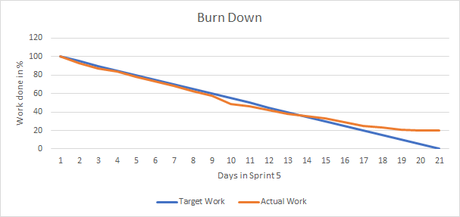
Burn Down Chart

Slide 25
Future Scope
Adding the timelines along with the task, so that the priorities can be set and tracked.
Making a cloud repository.
Adding setting page to customize the account.
Sending Email validation to confirm the user account.

Slide 26
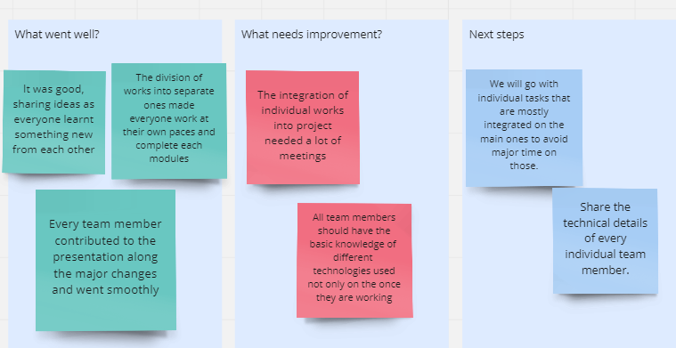
Retrospectives

Slide 27

GitHub Links
Project Link:
For Frontend: https://github.com/Vamshi399/cs691_project_management_tool/
For Backend:
https://github.com/saijeevan54/django
WiKi Page: https://github.com/Vamshi399/cs691_project_management_tool/wiki

Slide 28


